Slide 1
INVOiCE SImpLifier
Manage Accounts Simply

Slide 2
Who IS INVOICE SIMPLIFIER FOr
ANYONE WITH A BUSINESS

Slide 3
WHAT IS INVOICE SIMPLIFIER
A SIMPLE PRODUCTIVITY APP WHICH ANALYSES YOUR INVOICES

Slide 4
WHY INVOICE SIMPLIFIER
REDUCE THE COST OF MANUAL EFFORT
AUTOMATE PROCESSES
INVOICE ANALYTICS
EASY ACCESS

Slide 5
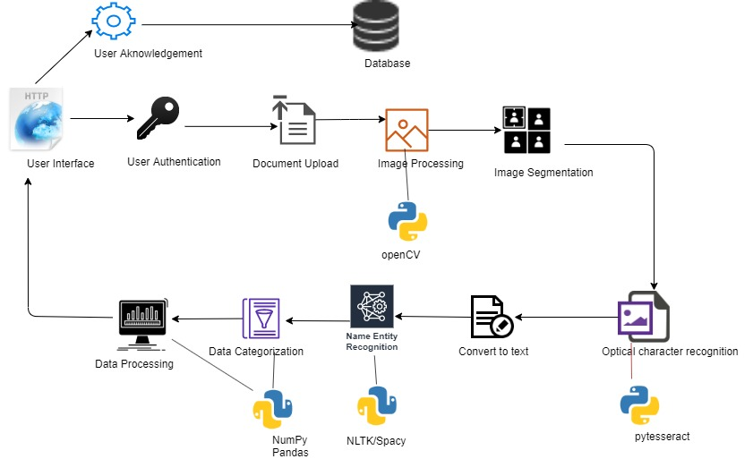
ARCHITECTURE

Slide 6
TECHNOLOGY STACK
Frontend - React / Vue
Backend - Nodejs and related libraries
Python - data processing. Libraries used:
Numpy, pillow and openCV - Image upscaling and segmentation
Pytesseract - OCR
Spacy / NLTK - Named entity recognition and catagorization
Numpy and pandas - Data processing

